Slide 1
UNIT-II
PLANNING AND ORGANISING

Slide 2
FUNCTIONS OF MANAGEMENT:
According to KOONTZ and O’DONNELL they can be classified under basic heads, namely
Planning
Organizing
Staffing
Directing
Controlling

Slide 3
Planning
Pre-determined course of action.
“Preparing a sketch or an outline of any proposed plan of actions”.
The process of planning thus involves the following activities:
Laying down objectives
Developing planning premises
Searching alternative courses of action
Evaluation of various alternatives and formulation of a plan
Formulating policies and procedures
Preparing schedules, programmes and budgets.

Slide 4
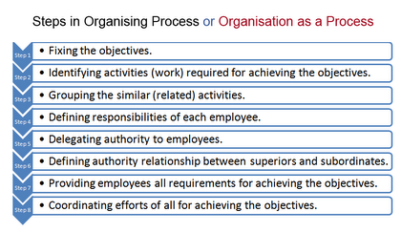
OrganisING
To organize means to put into working order and arrange in a system.
Process of arranging human resources & other resources to work together in order to attain organizational goals.

Slide 5
Staffing
Defined as manning and keeping manned the positions provided by the organization structure.
Man power planning i.e. determining the number and the kind of personnel required
Recruitment of personnel
Selection of the more suitable person
Placement and orientation of employees
Training and development of employees
Proper evaluation of employees
Transfer, promotion, termination and layoff of employees.

Slide 6
Directing
To direct means to guide and supervise any action or conduct.
It implies guidance or instructions about what to do and how to do it.
Direction function involves:
Issuing orders and instructions to subordinates.
Guiding, training, energizing and leading the subordinates to perform the work methodically.
Exercising supervision over the work done by subordinates to ensure that it is in conformity with aims and objectives of the enterprise.

Slide 7
Controlling
Controlling can be defined as “comparing results with plans and taking corrective action when results deviate from plans.”
process of controlling thus involves the following;
Determination of standards for measuring work performance
Measurement of actual performance
Comparing actual performance with the standard
Finding variance between the actual and the standards and the reasons for the same
Taking corrective action to ensure attainment of objectives.
For control to be effective and fruitful, it must be based on a plan.

Slide 8
POSDCORB
POSDCORB is an acronym which means
Planning,
Organizing,
Staffing,
Directing,
Coordinating,
Reporting and
Budgeting
which was first coined in a paper on administrative management that was written for the Brownlow Committee by Luther Gulick and Lyndall Urwick.

Slide 9
Steps of POSDCORB
POSDCORB is a series of steps for management
1.Planning
This essentially refers to establishing a broad sketch of the work to be completed and the procedures incorporated to implement them.
Planning is the first and most important step in POSDCORB as it sets the overall structure of the process with activities and timelines.

Slide 10
2.Organizing
Organizing involves formally classifying, defining and synchronizing the various sub-processes or subdivisions of the work to be done.
It makes sure that the activities and timelines in the first step of planning are refined and organized further so that right people can be staffed to execute these tasks.

Slide 11
3.Staffing
This involves recruiting and selecting the right candidates for the job and facilitating their orientation and training while maintaining a favorable work environment.
4.Directing
This entails decision making and delegating structured instructions and orders to execute them.
Directing is an important step in the POSDCORB cycle as it makes thing happen by giving clear objectives to teams and individuals.

Slide 12
5.Coordinating
This basically refers to orchestrating and interlinking the various components of the work.
6.Reporting
Reporting involves regularly updating the superior about the progress or the work related activities. The information dissemination can be through records or inspection.
7.Budgeting
Budgeting involves all the activities that under Auditing, Accounting, Fiscal Planning and Control.

Slide 13
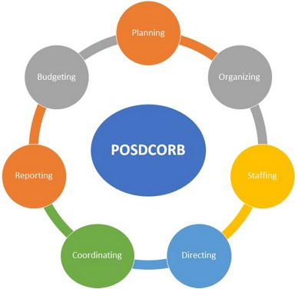

Slide 14
Importance of POSDCORB
Every business needs to have systematic framework in ensuring there is maximum output, minimum wastage and higher margins.
POSDCORB is one such method in management where workforce and employees can be managed in a way which would be beneficial for a company.
This concept helps organizations to break down the work into multiple processes and help in getting maximum value out to each employee.
These steps and stages of POSDCORB help the HR team to deliver to the needs of a company.

Slide 15
SKILLS OF MANAGER:
5 Managerial Skills are;
1. Technical Skill: Technical skill is knowledge of and proficiency in activities involving methods, processes, and procedures.
Thus it involves working with tools and specific techniques.
Technical skill is the ability to use the specialized knowledge, procedures, and techniques of a field of activities.

Slide 16
Most managers, especially at the lower and middle levels, need technical skills for effective task performance.
For example, mechanics work with tools, and their supervisors should have the ability to teach them how to use these tools.
Similarly, accountants apply specific techniques in doing their job.
This skill is most necessary and valuable at a supervisory level or first-level/first-level management.

Slide 17
2. Conceptual Skill:
Conceptual skill is the ability to see the “big picture,” to recognize significant elements in a situation and to understand the relationships among the elements.
It requires having the ability to visualize the enterprise as a whole, to envision all the functions involved in a given situation or circumstance, to understand how its parts depend on one another and anticipate how a change in any of its parts will affect the whole.

Slide 18
3. Interpersonal and Communication Skills:
Communication skill for a manager is a must. The manager must be able to convey ideas and information to others and receive information and ideas from others effectively.
Communication skill enables a manager to perform them properly. Most of his time, a manager’s job is to interact with people inside and outside of the organization.
A manager requires having an effective Interpersonal and communication skill to keep the responsibilities given to him.

Slide 19
4. Decision-Making Skill:
A manager’s job is to make decisions that will lead the organization to the attainment of is goals.
The skill that makes a manager able to recognize opportunities and threat and then select an appropriate course of action to tackle them efficiently so that the organization can benefit them.
Training or educating is also a good method to develop the Decision making the skill of a manager.

Slide 20
5. Diagnostic and Analytical Skills:
Diagnostic skill refers to the ability to visualize the best response to a situation.
Analytical skill means, the ability to identify the key variables in a situation.
After that is also helps a manager to visualize the result or outcomes of these approaches. This skill sounds similar to the decision making skill, but it is the skill required to make the decision.

